Slide 1
Research Methods Scientific research & Literature (SPEC 9997) Assignment 1 Student name = eamonn kelly Student number = D24127620 Date = Feb 2026

Slide 2
Some of the Databases and Journals Data sources checked
ACM Digital Library – Have access via TUDublin institutional licence
IEEE Xplore - Have access via TUDublin institutional licence
Sage Journals - Have access via TUDublin institutional licence
Cambridge Core - Have access via TUDublin institutional licence
Springer Nature Link – Have access via TUDublin institutional licence, but have to register to get ORCid with college account
Google Scholar – don’t always have access to the articles it references, can be a mixed bag, need to narrow searches with more specificity
DBLP – was very slow, not available through TU Dublin library
Use of the TU Dublin library was probably the greatest resource and allows for institutional access across a wide variety of

Slide 3
Predicting Company ESG Ratings from News Articles Using Multivariate Timeseries Analysis
Published on: ACM Digital Library
Date Published = 23rd May ‘2025
Number of Citations = 1
Total Downloads =1,350
Note: Click paper link above to view paper at source

Slide 4
The Purpose of the Research
Predicting Company ESG Ratings from News Articles Using Multivariate Timeseries Analysis?
Can a model be created that will accurately predict Company Environmental Social Governance (ESG) ratings based of existing and accessible (not company reported) data ?
Improvement on existing methodologies
ESG reporting is a legal governance requirement for companies in the EU.
ESG is an Important area, as it has financial and market performance implications for companies and investors.

Slide 5
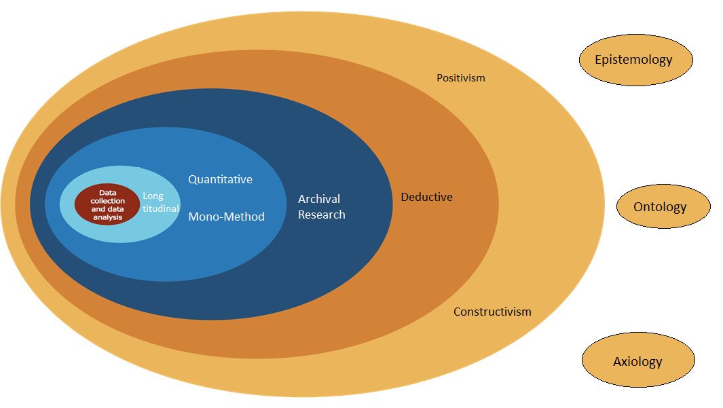
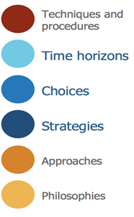
Research Onion Classification
The researchers adopted the above approach for their work

Slide 6
Philosophy – Epistemology (what is knowledge?)
It is - Positivism -
as it generates hypotheses (or research questions) that can be tested and allows explanations that are measured against accepted knowledge of the world we live in
research that can be replicated by other researchers to generate the same results.
emphasis is on quantifiable results that lend themselves to statistical analysis
It is extracting metrics, patterns and reproducible answers from data…not inferring any absolute truths, gaining a predicted accuracy….as the outcome
Knowledge is evaluated through observable data and predictive performance rather than claims of absolute truth…
Quantifiable / reproducible / testable data
It is not
Realism –
realism thinks that scientific methods are not perfect
theory can be revised and that our ability to know for certain what reality is may not exist without continually researching and leaving our minds open to using new methods of research.
Realism may therefore use several types of research methods to triangulate results in their search for a more reliable outcome
Time series element maps to realism -- theory can be revised and that our ability to know for certain what reality is may not exist without continually researching and leaving our minds open to using new methods of research
Interpretivism
meanings people confer upon their own and others' actions
approaches emphasizing the meaningful nature of people's participation in social and cultural life.

Slide 7
Philosophy – Ontology (what is reality?)
It is – Constructivism -
social phenomena are actually constructed by social actors
law is the product of the behaviour of the group of people it now has an impact on.
It is not
Objectivism? -
social phenomena and their meanings exist separately to social actors.
There is an argument that the environmental realities – i.e. pollution are absolute realities…. And we are measuring merely reflections of the absolute realities…. i.e. media data only occurs if theres realities of temp/pollution/gdpr breaches/diversity issues etc
Pragmatism
both constructivism and objectivism are valid ways to approach research. meanings people confer upon their own and others' actions
may be used to find solutions to problems.
Not really coming with any absolute defined version of truth… merely saying hey we can do this better to get a better solution to the problem

Slide 8
Layer 2. Approaches
It is –
Deductive
start with a statement/hypothesis or question and your research sets out to answer it.
The paper is stating “predicting ESG ratings from news articles by uniquely combining multivariate time series construction with advanced deep learning techniques”
The believe they can achieve this and then they set out to prove it…
Questions and hypothesis may be derived from informed speculation about the topic, that the researcher believes can be answered or tested
it is not
Inductive
researching to create theory.
research goes from research question to observation and description, to analysis and finally theory.

Slide 9
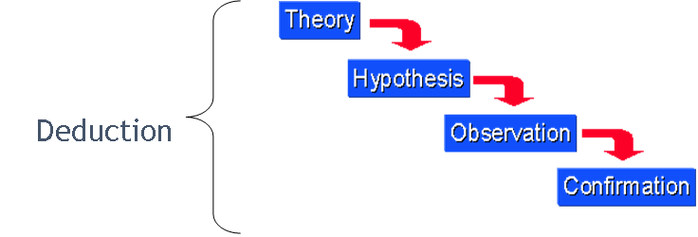

Slide 10
Layer 3. Strategy
Archival research
data collection on existing data sets or archive documents
exploratory, explanatory or descriptive analysis of changes tracked over a long period of time.
It is not,
Experiment - no causal or control groups, no speculated measurable effect
Survey – no surveys taken
Case Study -no case studies performed
Action research - not reflective or iterative
grounded theory – does not use inductive methods to predict or explain
Ethnography – is not a study of others

Slide 11
Layer 4. Choices
Is Quantitative
statistical data collected through empirical observation or from statistical digests
Is not Qualitative
Does not rely on opinion, personal accounts etc
Is Mono-method
Only quantitative data is collected and used
Is not mixed or multi method

Slide 12
Layer 5. Time Horizons
Is Longitudinal
study events and behaviours using concentrated samples over a longer period of time.
Is not Cross - Sectional
measures an aspect or behaviour of many groups or individuals and at a single point in time.

Slide 13
Layer 6. Techniques and procedures
It is a combination of both of the following.
Experimental
Methods = rigid in structure and process to enable the research to be replicated.
Tools = python, ML, neural networks (CNNs) x2 and transformer-based x2, DistilBERT model, k-means clustering
Formal Modelling
Methods = analytical, mathematical
Tools / Models = k-means clustering (k centroids, k=6), Neural Networks
There is no use of Surveys, Action Research, Case Studies, Grounded theory or Ethnography

Slide 14
Methodology
Data collection and Data Analysis

Slide 15
Step 1. Build the Datasets
1. Build Dataset
1.1 ESG ratings dataset creation
Used > Asset4 ESG ratings from Refinitiv1, - collected yearly ratings for 3,343 U.S. companies rated by Refinitiv from 2018 to 2020
Refinitiv scores based around E, S and G + 3 ratings, each 0-100) > higher = better
1 basic ESG score (based around company reports)
2. Controversy Score (based off external coverage, media etc)
3. combined score (controversy adjusted) (paper used this score for prediction)
Included some financials > test for company size (market cap influence on ESG)
NOTE > Refinitiv no longer exists was bought and no private company > https://www.lseg.com/en/data-analytics
1.2 News Dataset creation
GDELT project database > https://www.gdeltproject.org/
extensive database of news covering print, web, broadcast, and television sources from most countries around the world in over 100 languages, with updates every 15 minutes.
GDELT Doc API Client
‘from gdeltdoc import GdeltDoc, Filters’
https://pypi.org/project/gdeltdoc/
Performed a keyword search to include the 10 primary themes within the three ESG dimensions and company names (variations) each company name to appear twice to ensure focussed content and exclude incidental mentions

Slide 16
Overview of the News Article Dataset
 | 2018 | 2019 | 2020 | In Total
# of companies | 2665 | 2940 | 2879 | 8484
# of articles | 1,165,840 | 1,399,277 | 1,174,754 | 3,739,871
# of articles per company
average | 435 | 473 | 406 | 440
max | 1984 | 2154 | 2005 | 2154
Removed articles shorter than 200 characters and those with HTML errors, then extracted text content using the Beautiful Soup library3#
excluded companies with fewer than five collected articles to maintain a robust sample for each entity
removed extraneous noise, such as links, email addresses, dates, Unicode characters, and newline representations, which are common byproducts of scraping.
Due to the length limitations of the BERT models we employ, each article was reduced to its title and the first five sentences, ensuring manageable input size while retaining core content.
72% of articles were US sourced

Slide 17
Step 2. Create labelled ESG training data
1. Pre-label subset of articles by assessing semantic similarities to standard definitions of 3 ESG dimensions, ESG definitions from Corporate Finance Institute (CFI),to guide the labelling. https://corporatefinanceinstitute.com/
Note : This site no longer exists in this form. No specific definitions available any longer here.
100 companies randomly selected from the GDELT article dataset served as training, validation and testing base for classifier.
create pre-trained text embeddings for these ESG definitions and the news articles using the sentence transformer model ’all-distilroberta-v1’ (SBERT) from Huggingface (https://huggingface.co/
Pairwise cosine similarity with > 0.1 labelled as ‘relevant’, else = ‘noise’

Slide 18
Step 3. Train ESG classifier to predict relevant and non relevant ESG articles
fine-tune a pre-trained DistilBERT model on this pre-labeled dataset to predict labels for the entire corpus
10,500 = training set
2,100 = validation
57,088 = testing
Articles are tokenized with the DistilBertTokenizer from Huggingface, and the tokenized inputs are then fed into DistilBERT.
DistilBERT classifier is fine-tuned in two stages
1. customized classification layers are optimized
2. entire network is fine-tuned using a lower learning rate to ensure stability
Using the trained classifier, we then predict the relevance label for each article
Had 83% accuracy and labelled all 3.7 million articles either ‘relevant or ’noise”
Not bag-of-words/tf-IDF/One-Hot/Word2vec… but BERT

Slide 19
Step 4. generate the “Article2ESG Relevance” time series – filter all articles in the news articles corpus
Reflects the monthly relevance of articles to ESG topics
group the articles by month and by company
The monthly relevance value, 𝑟𝑒𝑙 −𝑛𝑜𝑖𝑠𝑒𝑚, is calculated according to the following formula:
𝑟𝑒𝑙 − 𝑛𝑜𝑖𝑠𝑒𝑚 = (𝑅𝑒𝑙𝑒𝑣𝑎𝑛𝑡𝑚/𝑁𝑚) − (𝑁𝑜𝑖𝑠𝑒𝑚/𝑁𝑚)
The resulting values range between -1 (indicating only noise articles) and 1 (indicating only relevant articles). Thus, for each company,
the Article2ESG Relevance time series comprises 12 𝑟𝑒𝑙−𝑛𝑜𝑖𝑠𝑒𝑚 values, one for each month of the analyzed year.

Slide 20
Step 5 . Perform Sentiment Analysis to relevant articles to crate sentiment scores.
To compute the sentiment time series,grouped articles by company and month and calculate a monthly sentiment ratio using the employ the SieBERT model
model’s output labels are used to generate a monthly article sentiment time-series for each company, calculated separately for ESG-relevant and irrelevant articles.
𝑝𝑜𝑠 − 𝑛𝑒𝑔𝑚 = (𝑃𝑜𝑠𝑖𝑡𝑖𝑣𝑒𝑚/𝑁𝑚) − (𝑁𝑒𝑔𝑎𝑡𝑖𝑣𝑒𝑚/𝑁𝑚)
The final Article Sentiment time series is constructed by concatenating these monthly values, resulting in a time series of 12 sentiment values per company for the analyzed year.

Slide 21
Step 6. Semantic Analysis (what the articles are about) – each article becomes a semantic vector representations
Vectorise each article using DistilBERT >These embeddings serve as input for the k-means clustering algorithm
Cluster the articles by content, using k-means
enabling us to track the evolution of key ESG-related topics discussed in the news over time
fine-tuning the DistilBERT model for the task of ESG classification to create task-specific embeddings for the articles.

Slide 22
Step 7 . Cluster articles into ESG topics
The results of this semantic analysis are integrated into the final ESG rating prediction model as time series data, with each time series corresponding to one of the six clusters. (k=6 –used elbow method)
articles are grouped by cluster to identify the total set of articles within each cluster. Then, within each cluster, articles are grouped by company to quantify the overall topic representation for each company.
The resulting 12 monthly values per company and cluster are concatenated, producing 6 semantic time series for each company. These time series capture the monthly prominence of each topic cluster, showing how dominant specific ESG topics are for each company over time.

Slide 23
Step 8. Create the multi variate time series feature sets
Aggregate the article conts and sentiment per cluster, per company per month
Creating multiple time series features for each firm
Combined
1 relevance time series
2 sentiment time series (positive or negative)
6 semantic time series from k-means clustering
= 9x12 matrix
Before feeding the data into the model, we standardize the time series using standard scaling (i.e. subtracting the mean and dividing by the standard deviation).

Slide 24
Step 9. Train the deep learning models to generate ESG ratings on the time series data
Used four models for generating ESG ratings based on the prepared time series data:
CNN-based approaches x2
Basic CNN –
The nine constructed input time series for each of the 12 months—specifically, the Article2ESG Relevance, Article Sentiment (2 time series), and Article Semantic time series (one for each of the 6 clusters)—form the model input as a (9 x 12) matrix.
Uses 1D convolutional layer / 1D max pooling / ReLu and softmax function probability of each class )
Deeper model
A convolution layer / batch normalization layer / a ReLU activation / global max pooling
Transformer-based approaches x2
a basic model integrating CNN with
a) single Transformer layer, and
b) a deeper model that combines CNN with a multi-layer Transformer encoder.
Regression and Classification configurations used
Uses Deep Learning methodologies 1D convolution, time –series dimension, ReLU to introduce non-linearity and softmax to convert outputs into probabilities

Slide 25
Step 9. CNN - basic convolutional neural network (CNN)

Slide 26
Step 9. CNN – Deeper Neural Network model

Slide 27
Step 9. CNN + Transformer Model

Slide 28
Step 10. Evaluation of ESG Rating
Values outcome from models
Classification
Accuracy = probability accuracy
Regression
Mean Absolute Percentage Error (MAPE) = avg % deviation between predicted and actual ESG scores, from regression configuration
Mean Squared Error (MSE) = average squared error, from regression

Slide 29
Model results for 2020 – (only displaying 2020 results)
 | Overall results - classification |  | Regression | Regression | Absolute Difference to Asset4 Rating
Classification Models | Accuracy (%) | SCC |  |  | Mean Abs Diff | Std Dev | Max Diff
Basic CNN | 2.2 | 4.29 |  |  | 15.27 | 12.23 | 64.6
Deep CNN | 2.3 | 4.38 |  |  | 15.72 | 12.43 | 58.1
CNN + Transformer | 2.3 | 4.49 |  |  | 15.81 | 12.57 | 62.4
CNN + Deep Transformer | 2.2 | 5.29 |  |  | 16.44 | 12.8 | 67.8
Regression Models |  |  | Mean Abs Percent Err (MAPE) | Mean Sqrd Err (MSE) | Mean Abs Diff | Std Dev | Max Diff
Basic CNN |  |  | 51.31 | 285.07 | 13.43 | 10.2 | 52.62
Deep CNN |  |  | 50.12 | 263.18 | 13.04 | 9.66 | 48.63
CNN + Transformer |  |  | 44.18 | 368.73 | 15.05 | 11.88 | 54.41
CNN + Deep Transformer |  |  | 50.66 | 294.75 | 13.36 | 10.59 | 73.38
Baseline Model – Predicting ESG scores | Accuracy (%) |  | MAPE | MSE | Mean Abs Diff | Std Dev | Max Diff
Mean Asset4 Rating | 2.2 |  | 43.64 | 365.63 | 14.79 | 12.02 | 55.94
Random Selection | 0.9 |  | 102.79 | 1167.99 | 28.1 | 19.48 | 83.8
Sokolov et al. [20] | 0.5 |  | 176.27 | 2108.27 | 41.46 | 19.74 | 89.89

Slide 30
Result and Conclusions
Deep CNN
Lower
CNN + Transformer
Lower mAPE but higher MSE => good avg accuracy but some large errors
Baselines
Very High MAPE and MSE => poor predictive performance
classification model accuracy is relatively low due to the challenging nature of predicting the correct rating out of 100 classes, and results vary significantly depending on the train-test split.
top-performing deep CNN, the basic CNN and deep Transformer regression models show strong performance in 2020.

Slide 31
Conclusions and Further Research
Using news articles from over 30,000 websites in approximately 200 countries, paper has shown that ESG ratings can be predicted reliably based on information from news sources.
Potential to enable various stakeholders, including private investors and government agencies, to monitor companies’ ESG compliance in a time- and resource-efficient manner.
Input processing pipeline comprises three main steps to derive inputs for the prediction model
1) article classification for ESG relevance,
2) sentiment estimation,
3) cluster-based time series generation
these derived time series significantly enhance ESG prediction performance, underscoring their importance as key features.
Limitations
Reliance on a single type of rating.
Future work
Explore alternative rating sources.
Consider bias detection techniques in news articles

Slide 32
Research Methods
The paper authors used Secondary research.
They used pre-existing data, published journals
They references 24 different references including published papers and books, across a range of publications such as Journal of Financial data, The Journal of Impact and ESG Investing, IEEE, Hugging face, Journal of Business Ethics and many more
It is not primary research
They did not generate the data themselves, collecting , generating data themselves

Slide 33
Overview of ESG Prediction Model

Slide 34
Additional references and observations
Among past ESG-related works, many either utilize ESG ratings to predict a range of other target variables or analyze the effects of ESG ratings on other target variables, instead of predicting ESG ratings or examining the effects of different information on ESG ratings.
A lot related to predicting financial implications
A lot of papers across databases sources from China
financial orientated and reporting obligations/process streamlining

Slide 35
References – APA6 style (generated using Zotero)
ACM Digital Library. (n.d.). Retrieved 9 February 2026, from https://dl-acm-org.tudublin.idm.oclc.org/
Aue, T., Jatowt, A., & Färber, M. (2025). Predicting Company ESG Ratings from News Articles Using Multivariate Timeseries Analysis. Companion Proceedings of the ACM on Web Conference 2025, WWW ’25, 1774–1780. https://doi.org/10.1145/3701716.3717509
CFI’s Home Page. (n.d.). Corporate Finance Institute. Retrieved 9 February 2026, from https://corporatefinanceinstitute.com/
dblp: Computer science bibliography. (n.d.). Retrieved 9 February 2026, from https://dblp.org/
gdeltdoc: A client for the GDELT 2.0 Doc API (Version 1.12.0). (n.d.). [Python; OS Independent]. Retrieved 9 February 2026, from https://github.com/alex9smith/gdelt-doc-api
Google Scholar. (n.d.). Retrieved 9 February 2026, from https://scholar.google.com/
Hugging Face – The AI community building the future. (2026, February 9). https://huggingface.co/
IEEE Xplore. (n.d.). Retrieved 9 February 2026, from https://ieeexplore-ieee-org.tudublin.idm.oclc.org/Xplore/home.jsp
LSEG Data & Analytics | Financial Technology & Data. (2026, February 5). https://www.lseg.com/en/data-analytics
Prathama, U. A., Purwarianti, A., & Septiandri, A. A. (2025). ESG-IDX: A Framework to Utilize ESG-Related News Sentiment for Indonesia Stock Price Prediction. 2025 12th International Conference on Advanced Informatics: Concept, Theory and Application (ICAICTA), 1–6. https://doi.org/10.1109/ICAICTA67604.2025.11335140
Sage Journals: Discover world-class research. (n.d.). Sage Journals. Retrieved 9 February 2026, from https://journals-sagepub-com.tudublin.idm.oclc.org/
The GDELT Project. (n.d.). Retrieved 9 February 2026, from https://www.gdeltproject.org/
Wu, C., & Gerber, M. S. (2018a). Forecasting Civil Unrest Using Social Media and Protest Participation Theory. IEEE Transactions on Computational Social Systems, 5(1), 82–94. https://doi.org/10.1109/TCSS.2017.2763128
[20] Sokolov, A., Mostovoy, J., Ding, J. and Seco, L. [2021], ‘Building machine learning systems for automated ESG scoring’, The Journal of Impact and ESG Investing 1(3), 39–50.
[21] Vaswani, A., Shazeer, N., Parmar, N., Uszkoreit, J., Jones, L., Gomez, A. N., Kaiser, Ł. and Polosukhin, I. [2017], ‘Attention is all you need’, Advances in neural information processing systems 30.

Slide 36
General Learnings
Can get sucked down a hole and spend days signing into a very specific area >> need to adhere to what your goals are and be strict about it… time goes…
Data source repositories change, and some no longer exists or have changed
Global Reporting Initiative (GRI) – gone or bought out
World Event/Interaction Survey (WEIS) Project, - ceased – cross-sectional
Refinitiv – bought out, no longer available
ACM a lot of ESG papers from China
A lot of ESG papers are financial impact orientated and ESG reporting obligations/process streamlining
Additional data sources - references other papers, a lot of general discussion but no absolute definitions around ESG.
United Nations Sustainable Development Goals (SDG)
United Nations Principles for Responsible Investments (UN PRI)
Network for Greening the Financial System (NGFS)

